Slide 1
Science Review
6th Grade

Slide 2
All matter is made from….
atoms

Slide 3
All matter has ________ and takes up _________
Mass; space

Slide 4
Is Kool-Aid a mixture or a solution?
solution

Slide 5
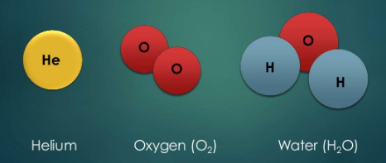
Which one is a compound?
water

Slide 6
Mass volume
What property does this formula calculate?
density

Slide 7
How many atoms of hydrogen are there in vinegar?
3

Slide 8
A property that is determined by senses and only changes the appearance of an object is a ___________ property
physical

Slide 9
Physical or chemical change?
Changing states of matter is a PHYSICAL change

Slide 10
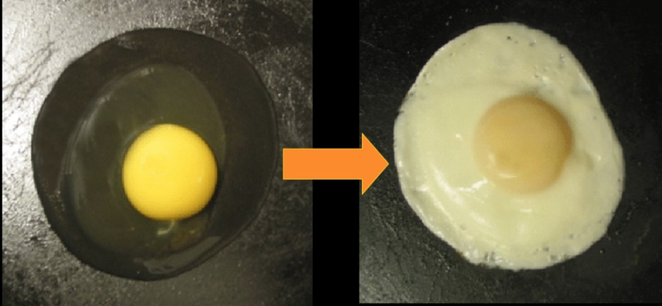
Physical or chemical change?
Cooking is a CHEMICAL change

Slide 11
A change in matter that produces one or more substances is a …..
Chemical change

Slide 12
A change in form or appearance is a …..
Physical change

Slide 13
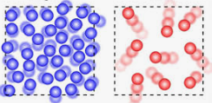
Which one is a gas?
Red…….How did you know?

Slide 14
Solid, liquid or gas? Which one has no set shape but a set volume?
Liquid

Slide 15
An increase or decrease of _______ causes a change in the state of matter
Heat (energy)

Slide 16
An increase in temperature is due to an increase in _________ energy
thermal

Slide 17
When kicking a soccer ball, the person is using their __________ energy
mechanical

Slide 18
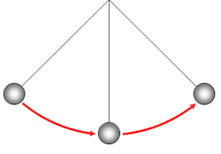
Between which point does potential energy change into kinetic energy?
A
C
B
Between

Slide 19
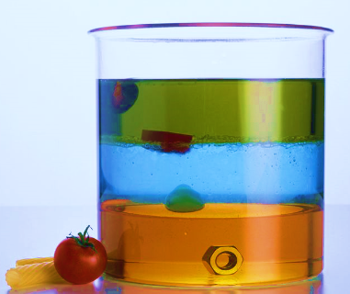
Which color liquid is the least dense?
green

Slide 20
Which object is the most dense?
Nut

Slide 21
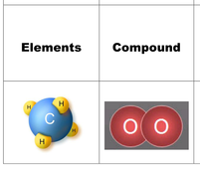
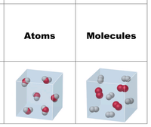
Arrange from least to most complex
Atoms-elements-molecules-compounds

Slide 22
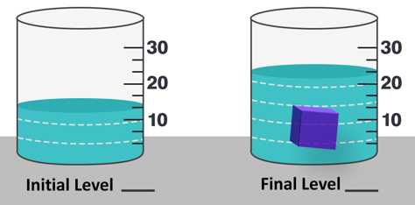
What is the volume of the blue cube?
10 mL

Slide 23
During evaporation, is energy absorbed or released?
absorbed

Slide 24
Stored energy is referred to as _______ energy
Potential

Slide 25
What type of energy is shown in all four pictures?
kinetic

Slide 26
Describe the change in energy.
Electrical energy to light (radiant) energy

Slide 27
Is this a transformation or a transfer of energy
transformation

Slide 28
What two things effect potential energy?
Height and Mass

Slide 29
What two things effect kinetic energy?
Speed and Mass

Slide 30
Both mass and energy have laws of conservation. What does it mean?
They cannot be created or destroyed.

