Slide 1
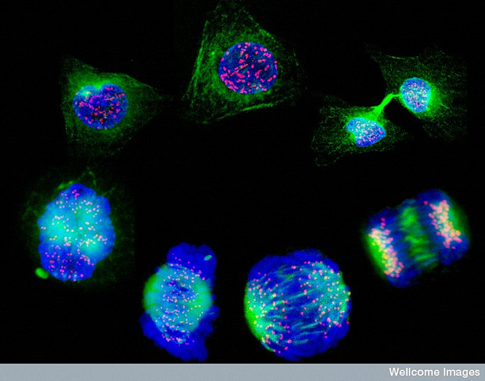
Cell Cycle & Cell Division

Slide 2
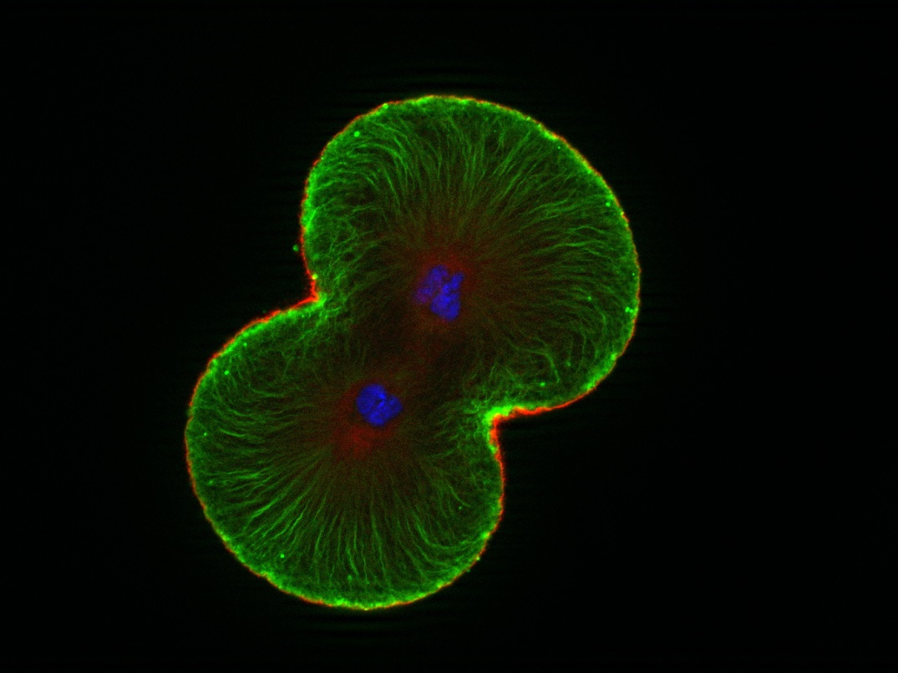
How long will a cell live before dividing?

Slide 3
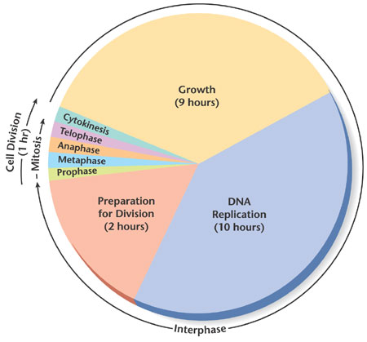
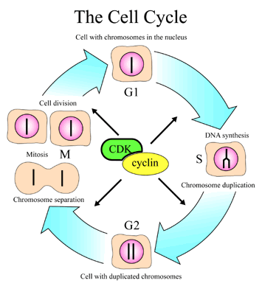
Cell Cycle
http://www.nobel.se/medicine/laureates/2001/press.html

Slide 4
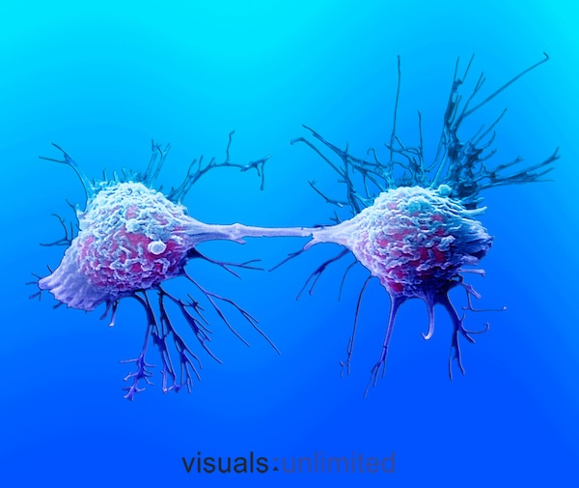
All cells come from pre-existing cells via the Cell Cycle
Interphase
Mitosis
Cytokinesis

Slide 5
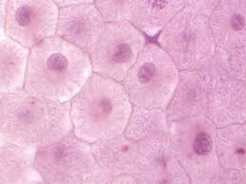
INTERPHASE
Also known as the Growth Phase

Slide 6
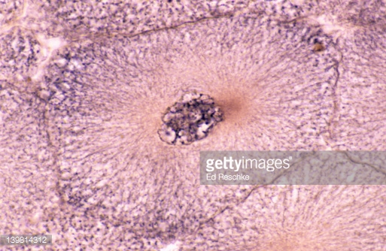
Interphase
This is the stage before mitosis
Cell must grow and produce all organelles for basic survival
The cell must make a copy of all chromosomes inside of its nucleus.

Slide 7
MITOSIS

Slide 8
Mitosis
Various stages where a single cell prepares to copy and divide its genetic material
Results in the creation of two identical daughter cells.
Each identical to original parent cell
Important for growth, reproduction and repairing or replacing damaged cells.

Slide 9
Stages of Mitosis (PMAT)
Prophase
Metaphase
Anaphase
Telophase & Cytokinesis

Slide 10
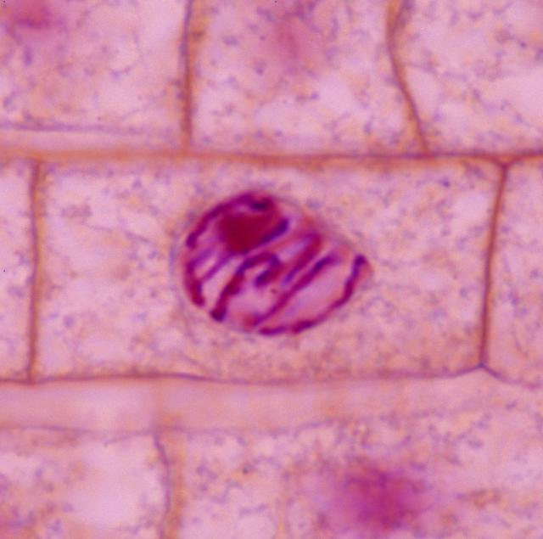
Prophase
Nucleus prepares for division by beginning to break apart.
This allows chromosomes to become free floating in the cytoplasm.
All Chromosomes copies are held together at the centromere to create an X formation

Slide 11
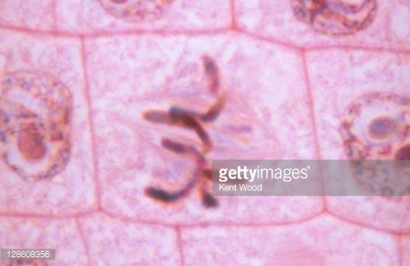
Metaphase
Chromosome line up in the center of the cell.
Spindle fibers attach to chromosomes at the centromere (where they are joined).

Slide 12
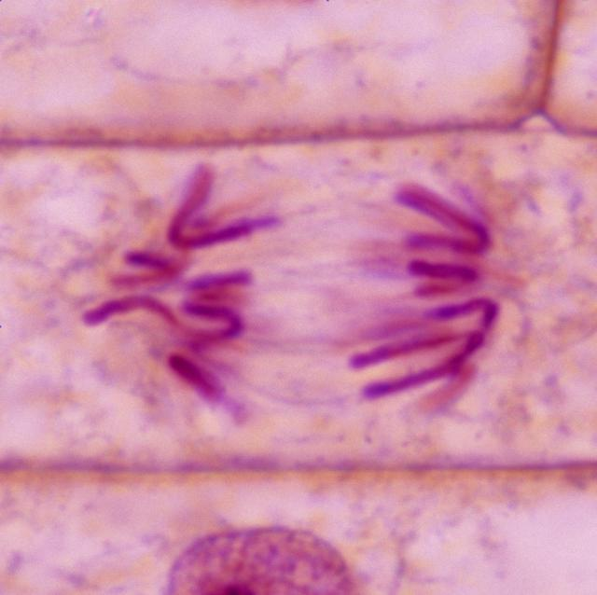
Anaphase
Spindle fibers begin to separate chromosome
One complete set is pulled to one side and the other complete set is pulled to the other side of the cell.
This ensures each cell has the exact same genetic material.

Slide 13
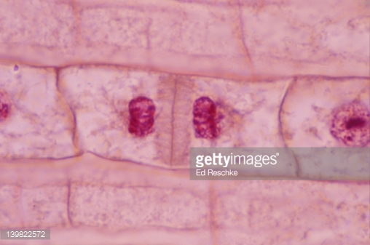
Telophase & Cytokinesis
Cytoplasm pinches in at the center of the cell
2 nuclei re-form around the chromosomes
Daughter cells are identical to parent cell.

Slide 14
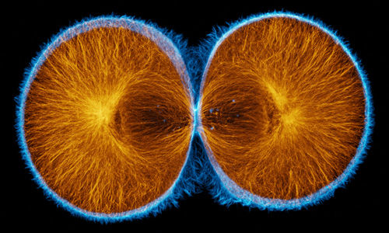
Telophase & Cytokinesis
Each daughter cell ends up with the same number of identical chromosomes
The cells will also have half the organelles and cytoplasm.

Slide 15
Mitosis Animation
http://www.cellsalive.com/mitosis.htm

