Slide 1
cells
ALL living things (organisms) contain cells!!

Slide 2
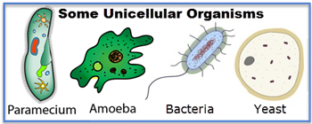
Defined as the smallest unit that is capable of performing life functions
May be a single cell: unicellular
OR
Many different cells: multicellular

Slide 3
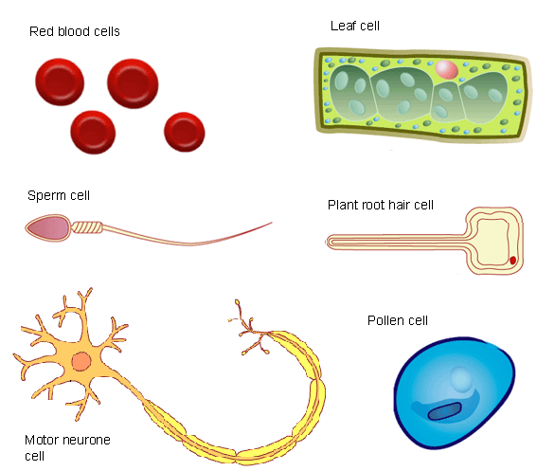
Come in many shapes and sizes
Usually based on
their functions

Slide 4
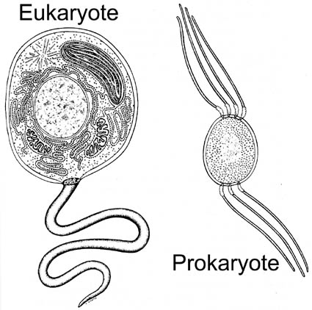
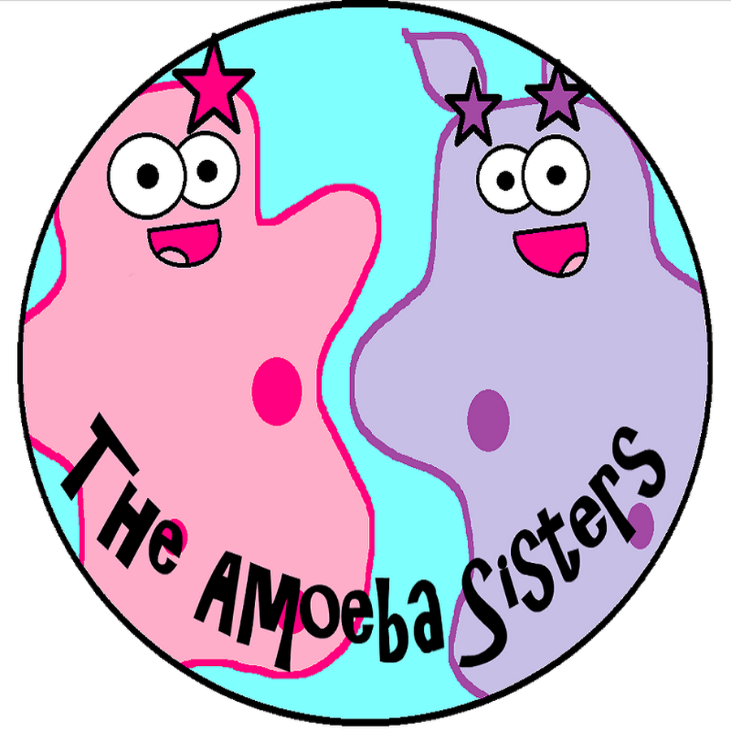
Two Types
http://www.youtube.com/watch?v=ruBAHiij4EA

Slide 5
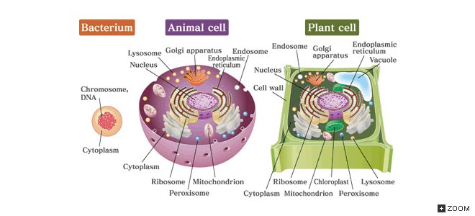

Slide 6
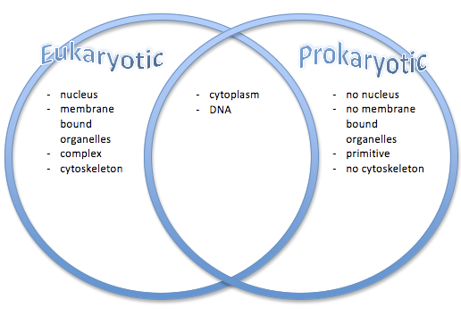

Slide 7
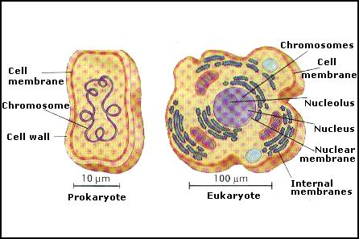
ALL cells have an orderly structure

Slide 8
Functions
EVERY cell carries out the functions of life
Obtain energy
Bring in water
Bring in nutrients
Get rid of wastes

Slide 9
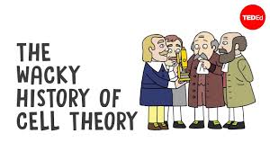
Cell Theory
Theory- An idea that has evidence and is widely accepted to be true
Three theories regarding cells:
They are the basic unit of all life
They make up ALL living things
All new cells are produced by existing cells
Click on picture to play video

